Slide 1
Double Linked List

Slide 2
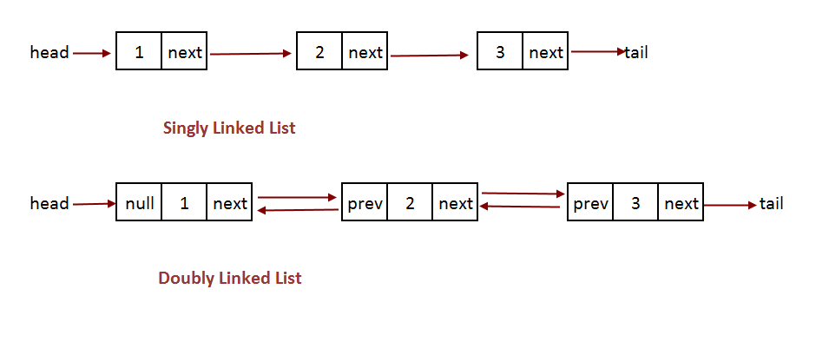
Double Linked List

Slide 3
operations on Double Linked List
In a double linked list, we perform the following operations...
Insertion
Deletion
Display

Slide 4
Insertion
In a double linked list, the insertion operation can be performed in three ways as follows...
Inserting At Beginning of the list
Inserting At End of the list
Inserting At Specific location in the list

Slide 5

Node Structure
struct Node
{
strunct Node *previous;
struct Node data;
struct Node *next;
}

Slide 6
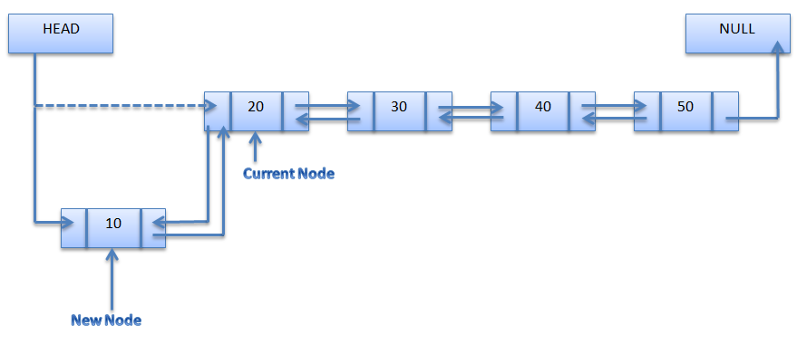
Inserting at Begin

Slide 7
Inserting At Beginning of the list
We can use the following steps to insert a new node at beginning of the double linked list...
Step 1 - Create a newNode with given value and newNode → previous as NULL.
Step 2 - Check whether list is Empty (head == NULL)
Step 3 - If it is Empty then, assign NULL to newNode → next and newNode to head.
Step 4 - If it is not Empty then, assign head to newNode → next and newNode to head.

Slide 8
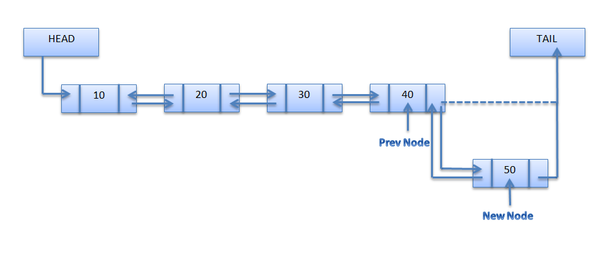
Inserting at End

Slide 9
Inserting at end
We can use the following steps to insert a new node at end of the double linked list...
Step 1 - Create a newNode with given value and newNode → next as NULL.
Step 2 - Check whether list is Empty (head == NULL)
Step 3 - If it is Empty, then assign NULL to newNode → previous and newNode to head.
Step 4 - If it is not Empty, then, define a node pointer temp and initialize with head.
Step 5 - Keep moving the temp to its next node until it reaches to the last node in the list (until temp → next is equal to NULL).
Step 6 - Assign newNode to temp → next and temp to newNode → previous.

Slide 10
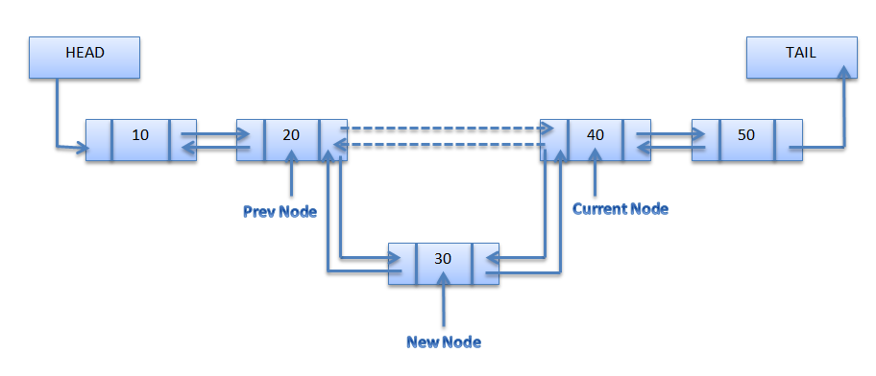
Inserting at given position

Slide 11
Inserting at given position
We can use the following steps to insert a new node at end of the double linked list...
Step 1 - Create a newNode with given value and newNode → next as NULL.
Step 2 - Check whether list is Empty (head == NULL)
Step 3 - If it is Empty, then assign NULL to newNode → previous and newNode to head.
Step 4 - If it is not Empty, then, define a node pointer temp and initialize with head.
Step 5 - Keep moving the temp to its next node until it reaches to the last node in the list (until temp → next is equal to NULL).
Step 6 - Assign newNode to temp → next and temp to newNode → previous.

Slide 12
Delete at begin
We can use the following steps to delete a node from beginning of the double linked list...
Step 1 - Check whether list is Empty (head == NULL)
Step 2 - If it is Empty then, display 'List is Empty!!! Deletion is not possible' and terminate the function.
Step 3 - If it is not Empty then, define a Node pointer 'temp' and initialize with head.
Step 4 - Check whether list is having only one node (temp → previous is equal to temp → next)
Step 5 - If it is TRUE, then set head to NULL and delete temp (Setting Empty list conditions)
Step 6 - If it is FALSE, then assign temp → next to head, NULL to head → previous and delete temp

Slide 13
Deletion at end
Step 1 - Check whether list is Empty (head == NULL)
Step 2 - If it is Empty, then display 'List is Empty!!! Deletion is not possible' and terminate the function.
Step 3 - If it is not Empty then, define a Node pointer 'temp' and initialize with head.
Step 4 - Check whether list has only one Node (temp → previous and temp → next both are NULL)
Step 5 - If it is TRUE, then assign NULL to head and delete temp. And terminate from the function. (Setting Empty list condition)
Step 6 - If it is FALSE, then keep moving temp until it reaches to the last node in the list. (until temp → next is equal to NULL)
Step 7 - Assign NULL to temp → previous → next and delete temp.

Slide 14
Deleting at given position
We can use the following steps to delete a specific node from the double linked list...
Step 1 - Check whether list is Empty (head == NULL)
Step 2 - If it is Empty then, display 'List is Empty!!! Deletion is not possible' and terminate the function.
Step 3 - If it is not Empty, then define a Node pointer 'temp' and initialize with head.
Step 4 - Keep moving the temp until it reaches to the exact node to be deleted or to the last node.
Step 5 - If it is reached to the last node, then display 'Given node not found in the list! Deletion not possible!!!' and terminate the fuction.
Step 6 - If it is reached to the exact node which we want to delete, then check whether list is having only one node or not
Step 7 - If list has only one node and that is the node which is to be deleted then set head to NULL and delete temp (free(temp)).
Step 8 - If list contains multiple nodes, then check whether temp is the first node in the list (temp == head).
Step 9 - If temp is the first node, then move the head to the next node (head = head → next), set head of previous to NULL (head → previous = NULL) and delete temp.
Step 10 - If temp is not the first node, then check whether it is the last node in the list (temp → next == NULL).
Step 11 - If temp is the last node then set temp of previous of next to NULL (temp → previous → next = NULL) and delete temp (free(temp)).
Step 12 - If temp is not the first node and not the last node, then set temp of previous of next to temp of next (temp → previous → next = temp → next), temp of next of previous to temp of previous (temp → next → previous = temp → previous) and delete temp (free(temp)).

Slide 15
Displaying Double Linked List
Step 1 - Check whether list is Empty (head == NULL)
Step 2 - If it is Empty, then display 'List is Empty!!! Deletion is not possible' and terminate the function.
Step 3 - If it is not Empty then, define a Node pointer 'temp' and initialize with head.
Step 4 - Check whether list has only one Node (temp → previous and temp → next both are NULL)
Step 5 - If it is TRUE, then assign NULL to head and delete temp. And terminate from the function. (Setting Empty list condition)
Step 6 - If it is FALSE, then keep moving temp until it reaches to the last node in the list. (until temp → next is equal to NULL)
Step 7 - Assign NULL to temp → previous → next and delete temp.

Slide 16
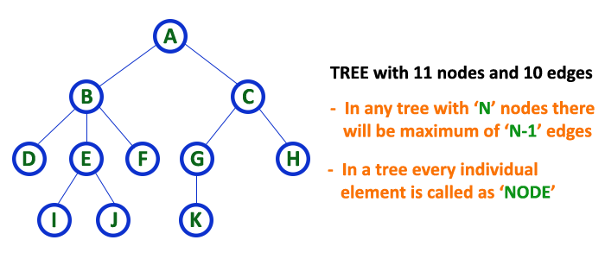
Trees
Tree is a non-linear data structure which organizes data in hierarchical structure.

Slide 17
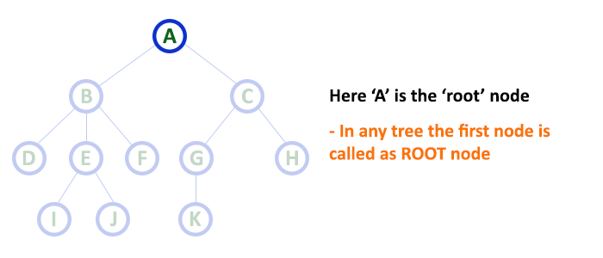
Tree Terminology
Root Node

Slide 18
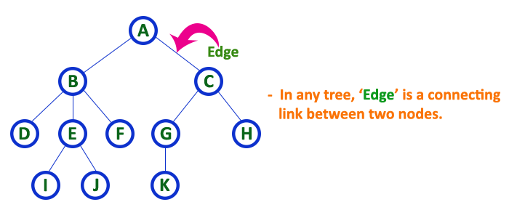
Tree Terminology
Edge

Slide 19
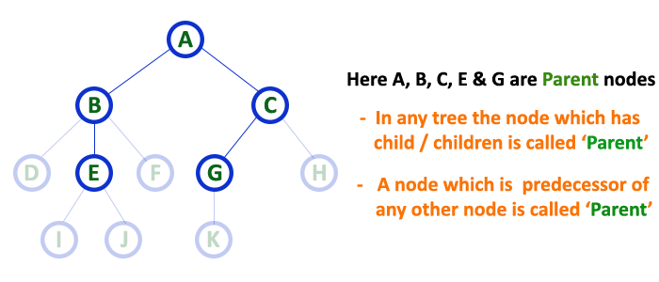
Tree Terminology
Parent

Slide 20
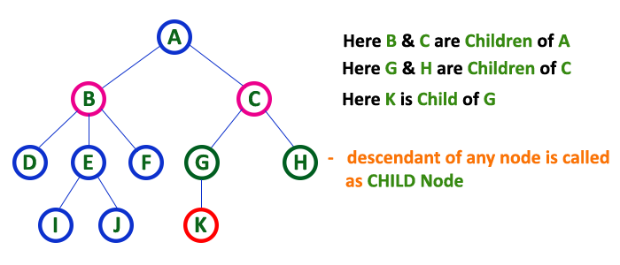
Tree Terminology
Child

Slide 21
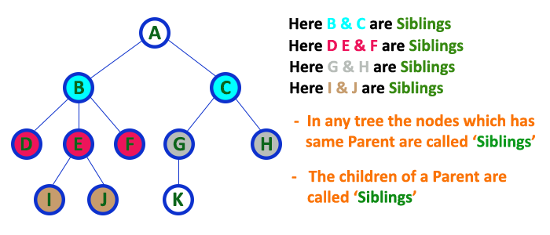
Tree Terminology
Siblings

Slide 22
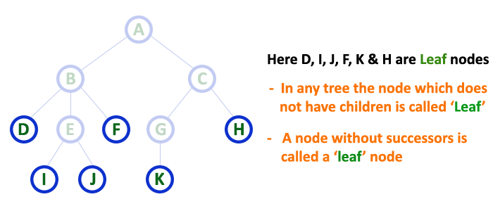
Tree Terminology
Leaf

Slide 23
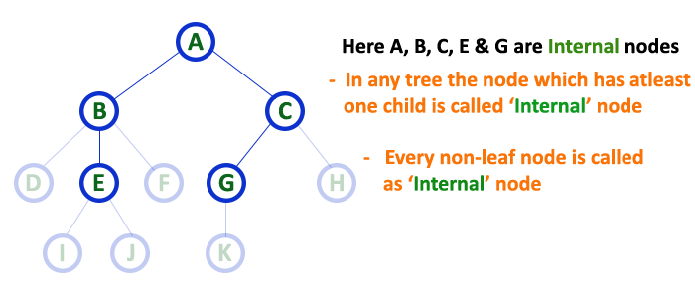
Tree Terminology
Internal Node : if any node contain at least one child

Slide 24
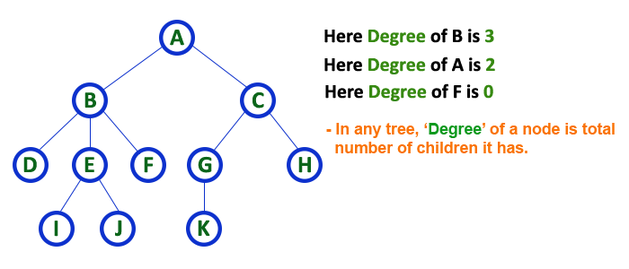
Tree Terminology
Degree

Slide 25
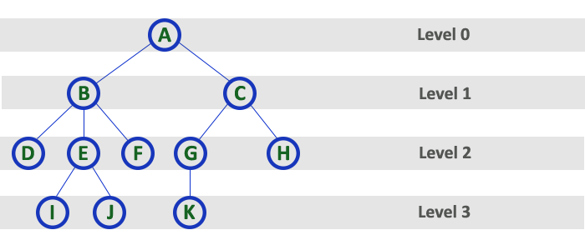
Tree Terminology
Levels

Slide 26
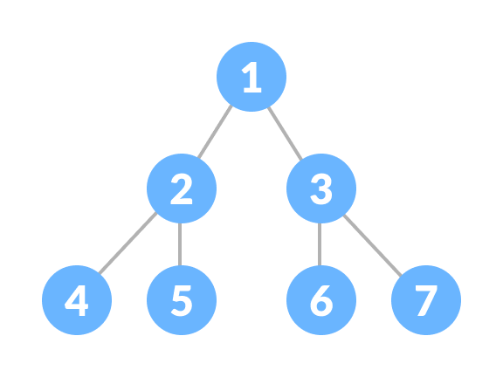
Binary Tree
A tree in which every node can have a maximum of two children is called Binary Tree.

Slide 27
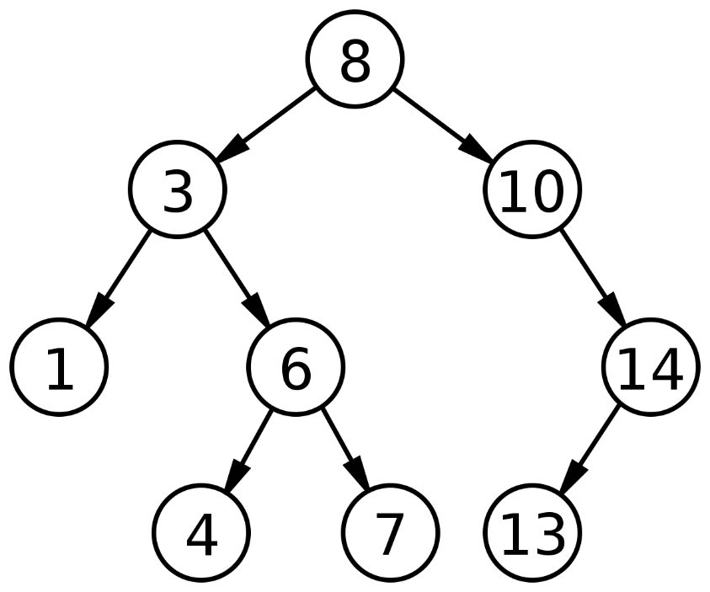
Binary Search Tree
Left Child value less than to parent Node
Right child Value Greater than to Parent Node

Slide 28
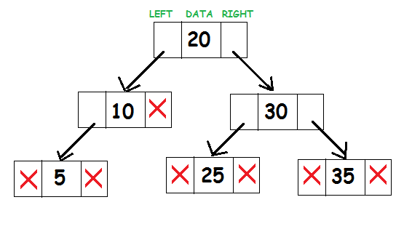
Linked List Representation of BST

